Slide 1

Acceptable
Documentation
Reimbursement Receipts

Slide 2

Ensuring Your QHP Documentation is Acceptable
Name of Patient/Member – We need to associate the document with a member seeking reimbursement
Date of Service/Goods Purchased – We must confirm payment is for services that were incurred in the current plan year and on or after the benefit effective date for
the member
What the monies were paid towards – We require
proof the member paid for services/goods covered by their health insurance plan.
      Note: We NEVER need your medical diagnosis.
      We do need to see that charges were for an eligible expense: Covered Rx, Copay, Coinsurance, Deductible, etc.
Amount – We need to see the amount needed for reimbursement
Reimbursement Receipts
What is required to be accepted?

Slide 3
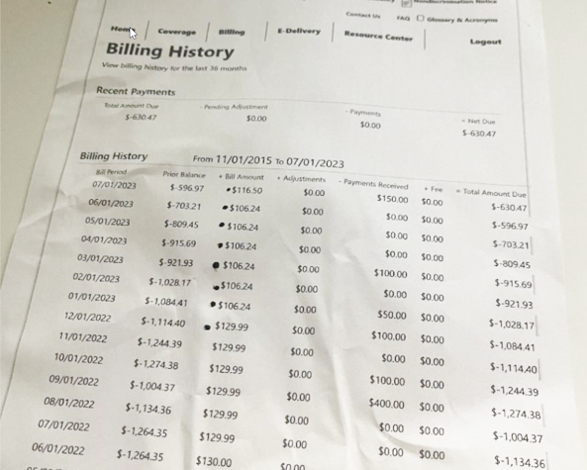
Ensuring Your QHP Documentation is Acceptable
Reimbursement Receipts
Unacceptable
We do not show a member name,
we do not show what these payments were for (copay, RX, coinsurance, etc.) and some of the dates are in the year 2022 and 2023.

Slide 4
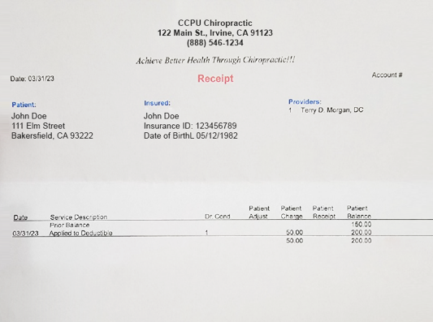
Ensuring Your QHP Documentation is Acceptable
Reimbursement Receipts
Partially Acceptable
Claim for $200.00 – We would approve and only pay $50.00 which shows as applied to deductible but would require additional information for the prior balance of $150.00 and would deny that amount until additional documentation is submitted.

Slide 5
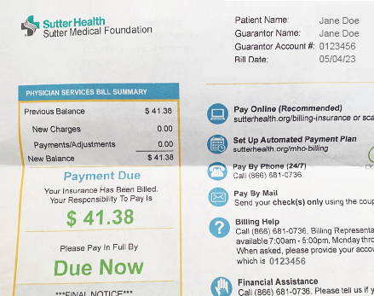
Ensuring Your QHP Documentation is Acceptable
Reimbursement Receipts
Unacceptable
We would need a supplementary document showing the date of service for the $41.38. We are able to see in the box on the left that the hospital
did bill the member’s insurance, and this is the member responsibility, so
we are confident the charge is eligible. We need the date of service to ensure the charges are for goods/services occurring on or after the member benefit start date.

Slide 6
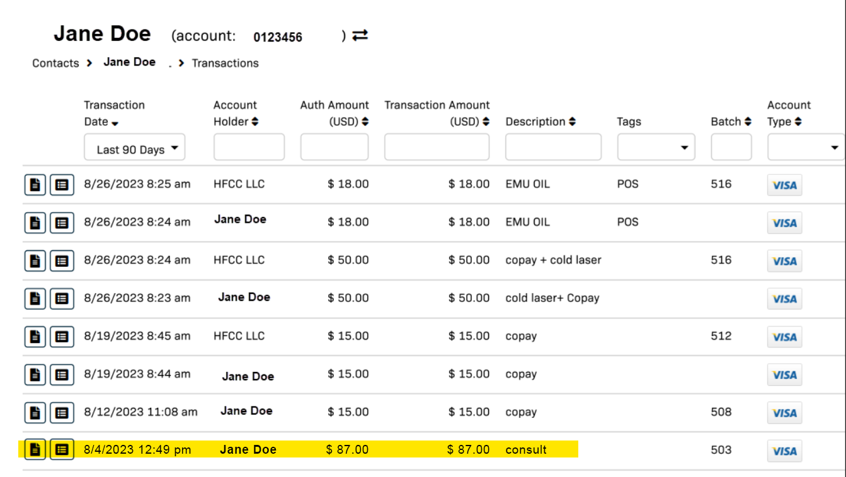
Ensuring Your QHP Documentation is Acceptable
Reimbursement Receipts
Unacceptable
We do not show that this payment
of $87.00 was for an eligible expense covered by insurance (copay, RX, premium, etc).

Slide 7
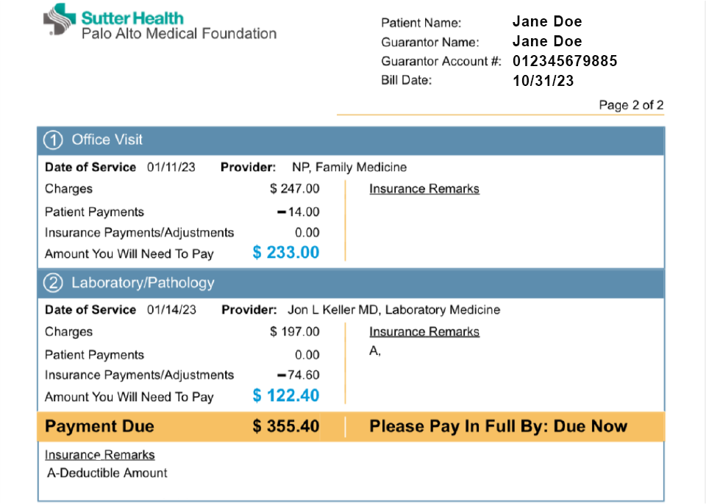
Ensuring Your QHP Documentation is Acceptable
Reimbursement Receipts
Acceptable
Documentation shows Name of Member, Date of Service, shows
what services were paid for (office visit and labs), and shows what
the patient/member monetary responsibility is (amount we will reimburse).

Slide 8
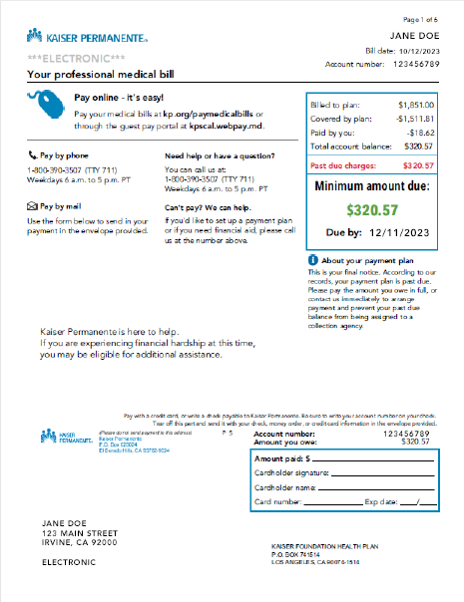
Ensuring Your QHP Documentation is Acceptable
Reimbursement Receipts
Unacceptable
This is not acceptable. We do not have a date of service, information on what this total applies to (copay, Rx, deductible, etc.) and we cannot verify who these charges are for (bill is in spouse name, unable to verify if charges are for an enrolled member on the MERP).

Slide 9
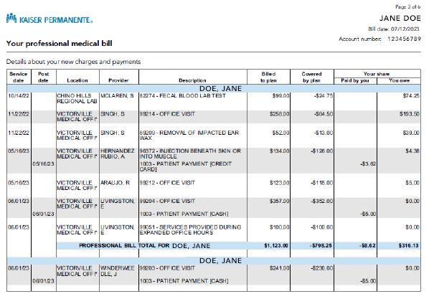
Ensuring Your QHP Documentation is Acceptable
Reimbursement Receipts
Acceptable
Documentation shows Name of Member, Date of Service, shows what services were paid for (office visit, procedures and labs) and shows what the patient/provider monetary responsibility is (amount we will reimburse) AFTER insurance pays their portion (Covered by Plan).

